Slide 1
Multithreaded programming
Java provides built-in support for multithreaded programming. A multithreaded program contains two or more parts that can run concurrently. Each part of such a program is called a thread, and each thread defines a separate path of execution. Thus, multithreading is a specialized form of multitasking.

Slide 2
The Java Thread Model
The Java run-time system depends on threads for many things, and all the class libraries are designed with multithreading in mind. In fact, Java uses threads to enable the entire environment to be asynchronous. This helps reduce inefficiency by preventing the waste of CPU cycles.
Single-threaded systems use an approach called an event loop with polling. In this model, a single thread of control runs in an infinite loop, polling a single event queue to decide what to do next.

Slide 3
The benefit of Java’s multithreading is that the main loop/polling mechanism is eliminated. One thread can pause without stopping other parts of your program. For example, the idle time created when a thread reads data from a network or waits for user input can be utilized elsewhere. Multithreading allows animation loops to sleep for a second between each frame without causing the whole system to pause. When a thread blocks in a Java program, only the single thread that is blocked pauses. All other threads continue to run.

Slide 4
Thread states
Threads exist in several states.
A thread can be running. It can be ready to run as soon as it gets CPU time. A running thread can be suspended, which temporarily suspends its activity.
A suspended thread can then be resumed, allowing it to pick up where it left off.
A thread can be blocked when waiting for a resource. At any time, a thread can be terminated, which halts its execution immediately. Once terminated, a thread cannot be resumed.

Slide 5
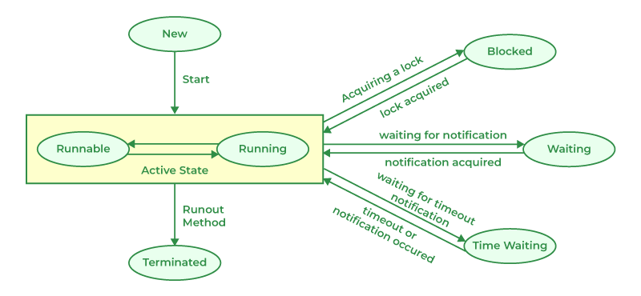
New State 2. Runnable State 3. Blocked State 4. Waiting State
Timed Waiting State 6. Terminated State

Slide 7
Creating Threads
Threads are implemented in the form of objects that contain a method called run()
run() method contains the entire body of the thread.
It is the only method in which the thread’s behavior can be implemented.

Slide 8
Contd….
Public void run()
{ ………
……(stmt for implementing thread)
}
A new thread can be created in two ways:
By creating a thread class
By converting a class to a thread

Slide 9
By creating a thread class:- define a class that extends Thread class and override its run() method with the code required by the thread.
By converting a class to a thread:- Define a class that implements Runnable inteface. The runnable inteface has only one method, run() that is to be defined in the method with the code to be executed by the thread.

Slide 10
Extending the thread class
Declare the class as extending the thread class.
Implement the run( ) method that is responsible for executing the sequence of code that the thread will execute.
Create the thread object and call the start( ) method to initiate the thread execution.

Slide 11
Creating a thread
class A extends Thread
{
public void run()
{
for(int i=1;i<=5;i++)
{
System.out.println("\t form threadA: i= " +i);
}
System.out.println("Exit form A");
}
}

Slide 12
Contd…
class threadtest1
{
public static void main( String s[ ])
{
new A().start();
}
}

Slide 13
Creating multiple thread using Thread class
class A extends Thread
{
public void run()
{
for(int i=1;i<=5;i++)
{
System.out.println("\t form threadA: i= " +i);
}
System.out.println("Exit form A");
}
}

Slide 14
Contd……
class B extends Thread
{
public void run()
{
for(int j=1;j<=5;j++)
{
System.out.println("\t form threadB: j= " +j);
}
System.out.println("Exit form B");
}
}

Slide 15
Contd….
class C extends Thread
{
public void run()
{
for(int k=1;k<=5;k++)
{
System.out.println("\t form threadC: k= " +k);
}
System.out.println("Exit form C");
}
}

Slide 16
Contd….
class threadtest
{
public static void main( String s[ ])
{
new A().start();
new B().start();
new C().start();
}
}

Slide 17
Stopping and Blocking a thread
Stopping a thread:- whenever we want to stop a thread from running , we can do by calling the stop() method.
for example:- obeject_name.stop();
Above statement causes the thread to the dead state automatically when its reaches the end of its method. The stop() method may be used when the premature death of a thread is desired.

Slide 18
Blocking a threads
A thread can also be temporarily suspended or blocked from entering into the runnable and subsequently running state by using either of the following thread methods:
sleep( ) // blocked for a specified time.
suspend( ) // blocked until further orders.
wait( ) // blocked until certain condition occurs.

Slide 19
Use of yield(), stop(), and sleep() methods
class A extends Thread
{
public void run()
{
for(int i=1;i<=5;i++)
{
if(i==1) yeild();
System.out.println("\t form threadA: i= " +i);
}
System.out.println("Exit form A");
}
}

Slide 20
Contd….
class B extends Thread
{
public void run()
{
for(int j=1;j<=5;j++)
{
System.out.println("\t form threadB: j= " +j);
if(j==3)
stop();
}
System.out.println("Exit form B");
} }

Slide 21
Contd……
class C extends Thread
{ public void run()
{
for(int k=1;k<=5;k++)
{
System.out.println("\t form threadC: k= " +k);
if(k==1)
try
{ sleep(1000); }
catch( Exception e)
{ }
}
System.out.println("Exit form C");
}
}

Slide 22
Contd…
class threadtest
{
public static void main( String s[ ])
{
A threadA= new A();
B threadA= new B();
C threadA= new C();
threadA.start();
threadB.start();
threadC.start();
}
}

Slide 23
Yield():- Currently executed thread object to be temporarily pause and allow other threads to execute.

Slide 24
using isAlive() and join()
Two ways exist to determine whether a thread has finished. First, you can call isAlive( ) on the thread. This method is defined by Thread, and its general form is shown here:
final boolean isAlive( )
The isAlive( ) method returns true if the thread upon which it is called is still running.
It returns false otherwise.

Slide 25
While isAlive( ) is occasionally useful, the method that you will more commonly use to wait for a thread to finish is called join( )
final void join( ) throws InterruptedException
This method waits until the thread on which it is called terminates. Its name comes from the concept of the calling thread waiting until the specified thread joins it.

Slide 26
How to use the isAlive() and Join()
class NewThread implements Runnable {
String name; // name of thread
Thread t;
NewThread(String threadname) {
name = threadname;
t = new Thread(this, name);
System.out.println("New thread: " + t);
t.start(); // Start the thread
}

Slide 27
// This is the entry point for thread.
public void run() {
try {
for(int i = 5; i > 0; i--) {
System.out.println(name + ": " + i);
Thread.sleep(1000);
}
} catch (InterruptedException e) {
System.out.println(name + " interrupted.");
}
System.out.println(name + " exiting.");
}
}

Slide 28
class DemoJoin {
public static void main(String args[]) {
NewThread ob1 = new NewThread("One");
NewThread ob2 = new NewThread("Two");
NewThread ob3 = new NewThread("Three");
System.out.println("Thread One is alive: "+ ob1.t.isAlive());
System.out.println("Thread Two is alive: "+ ob2.t.isAlive());
System.out.println("Thread Three is alive: "+ob3.t.isAlive());
// wait for threads to finish
try {
System.out.println("Waiting for threads to finish.");
ob1.t.join();

Slide 29
ob2.t.join();
ob3.t.join();
} catch (InterruptedException e) {
System.out.println("Main thread Interrupted");
}
System.out.println("Thread One is alive: “ + ob1.t.isAlive());
System.out.println("Thread Two is alive: “ + ob2.t.isAlive());
System.out.println("Thread Three is alive: “ + ob3.t.isAlive());
System.out.println("Main thread exiting.");
}
}

Slide 30
Explanation
Creates three NewThread objects (ob1, ob2, and ob3), each with a different name ("One", "Two", "Three").
Checks if each thread is alive using isAlive() and prints the status.
Calls join() on each thread to make the main thread wait for these threads to finish execution.
If InterruptedException is caught during join(), a message is printed indicating that the main thread was interrupted.
Checks and prints the status of each thread again after they finish.
Prints a message indicating the main thread is exiting.

Slide 31
Output
New thread: Thread[One,5,main]
New thread: Thread[Two,5,main]
New thread: Thread[Three,5,main]
One: 5
Two: 5
Three: 5
One: 4
Two: 4
Three: 4 ... One: 1 Two: 1 Three: 1 One exiting. Two exiting. Three exiting.

Slide 32
Thread One is alive: true
Thread Two is alive: true
Thread Three is alive: true
After the join() calls complete (when the main thread waits for the other threads to finish), the status of each thread is checked again:
Waiting for threads to finish.
Thread One is alive: false
Thread Two is alive: false
Thread Three is alive: false
Main thread exiting.

Slide 33
The isAlive() method checks whether a thread is still running at the time it is called.
join() ensures the main thread waits for ob1, ob2, and ob3 to complete before continuing.
The final output shows that after join() completes, all threads have finished, indicated by false from the isAlive() checks.

Slide 34
synchronization
When two or more threads need access to a shared resource, they need some way to ensure that the resource will be used by only one thread at a time. The process by which this is achieved is called synchronization.
Key to synchronization is the concept of the monitor (also called a semaphore).
A monitor is an object that is used as a mutually exclusive lock, or mutex. Only one thread can own a monitor at a given time. When a thread acquires a lock, it is said to have entered the monitor. All other threads attempting to enter the locked monitor will be suspended until the first thread exits the monitor

